Slide 1
Chronic Chagas Disease and Potential Natural Products
National Taiwan University
Hanne Inez Wolff
June 26th, 2013

Slide 2
Research Proposal
Chagas Disease is affecting 10-15 million people world wide, especially in rural areas of Latin America. There are two phases to the disease; the acute phase which lasts about 4-8 weeks, and the chronic phase which follows the acute phase.
Currently, there are only two drugs to treat Chagas disease, which are both not approved by the FDA, and to get a hold of the drugs, infected individuals must request them through the CDC and follow strict protocols. More importantly, these two drugs, despite their serious side effects, have shown efficiency only in infected individuals with acute Chagas Disease.
My research is looking at potential Natural Products to treat chronic Chagas Disease via utilizing computational modeling and predictions.

Slide 3
Current Developments
Initially I have been looking at two proteins namely, GP63, and Trans-sialidase to inhibit their function.
Due to literature research I have started to look at Trans-sialidase more carefully, and have done a few Docking scenarios using AutoDock Vina, and AutoDock Tools
The database I’m screening against is called Taiwan Pharmaceutical Database, which contains about 2,000 compounds (http://tpd.mc.ntu.edu.tw/index.php)
Downloaded and have obtained the academic license for MarvinSketch in order to transform 2D molecular structures to 3D molecular structures

Slide 4
Goals – next week
Continue screening against the database
Have spoken to Dr. Lin regarding homology modeling of mucin-like proteins, which have significant importance in chronic stage Chagas. Continue work on creating a potential model
Considering to drop the gp63 protein for the mucin-like protein
Continue reading articles

Slide 5

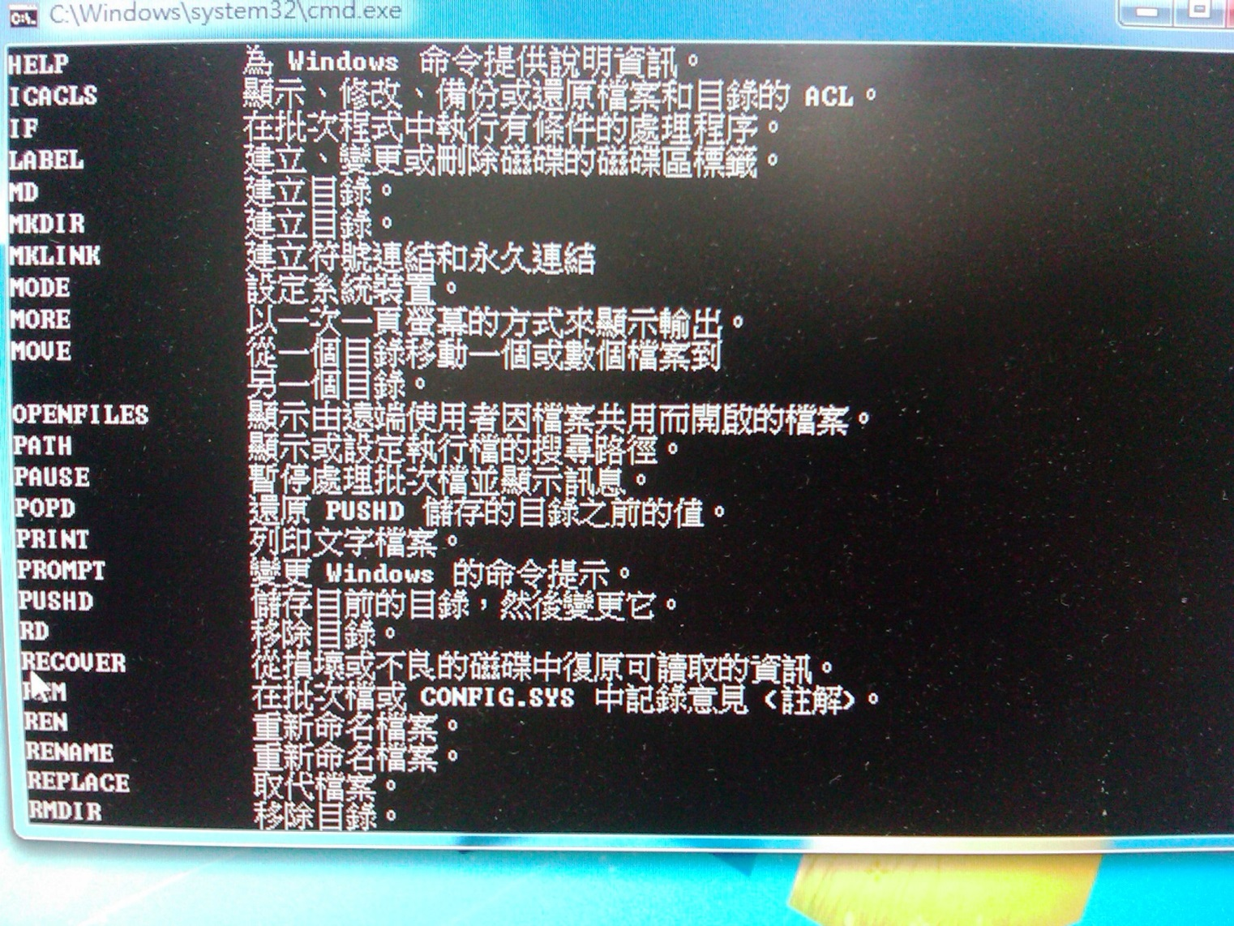


Cultural Fun

